Slide 1

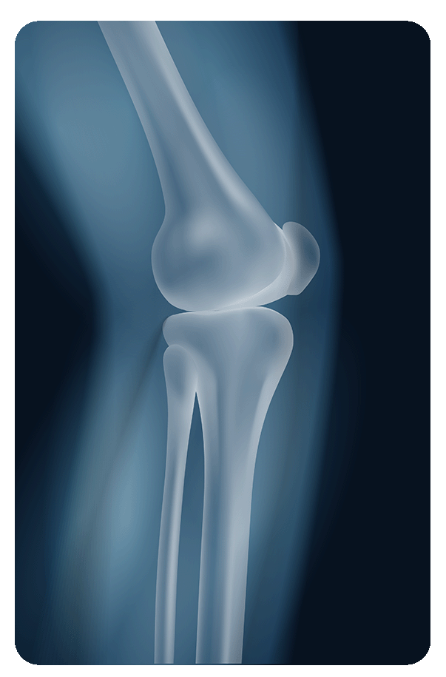
Automated Radiology Report Generation on Chest X-ray
Supervisor Name: Dr. Bushra Naz
Group members: 20CS059(GL), 20CS053, 20CS079
Department of computer systems engineering, MUET Jamshoro

Slide 2
CONTENTS
01. | Introduction
02. | Literature Review
03. | Summary of Literature Review
04. | Problem Statement
05. | Aims and Objectives
06. | Mapping of project with SDGs & CEP
07. | Methodology
08. | Tools & Technologies
09. | Data Collection & Preprocessing
10. | Model Evolution and Selection
11. | Verification of Generated Report
12. | Results
13. | References

Slide 3
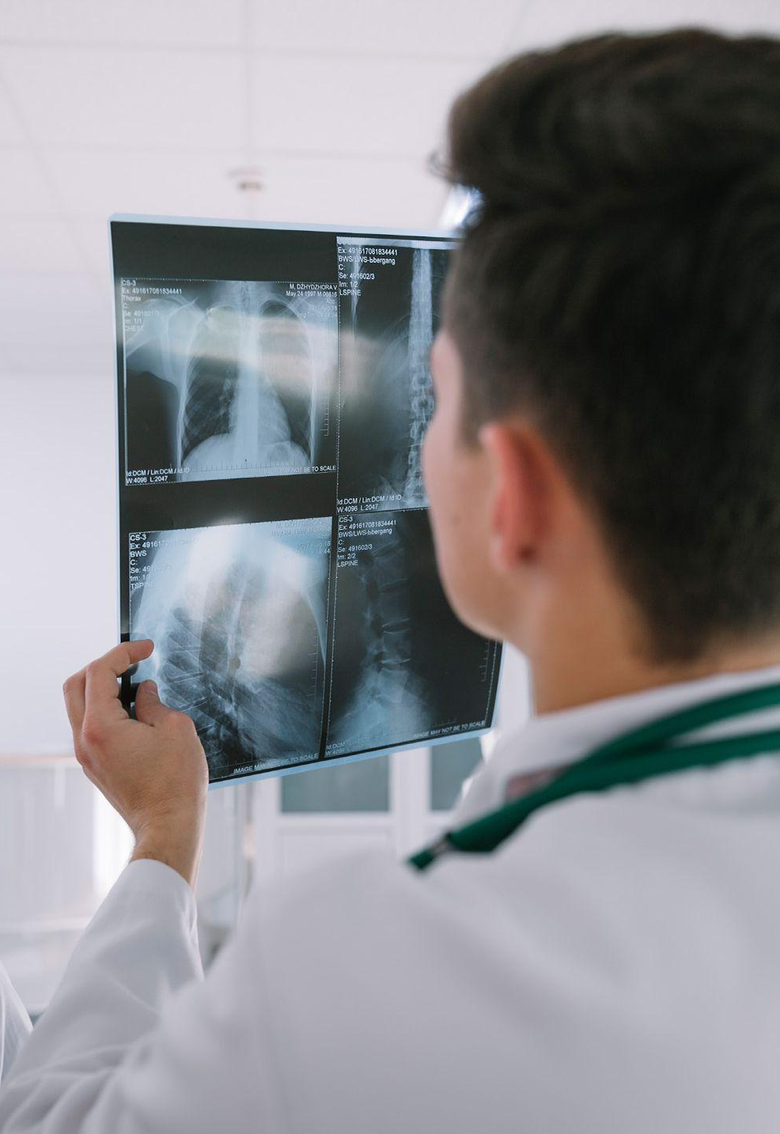
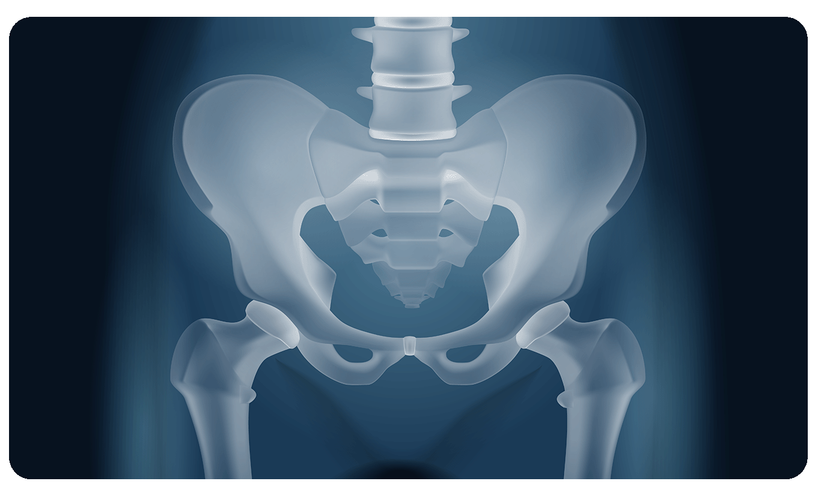
01
INTRODUCTION

Slide 4
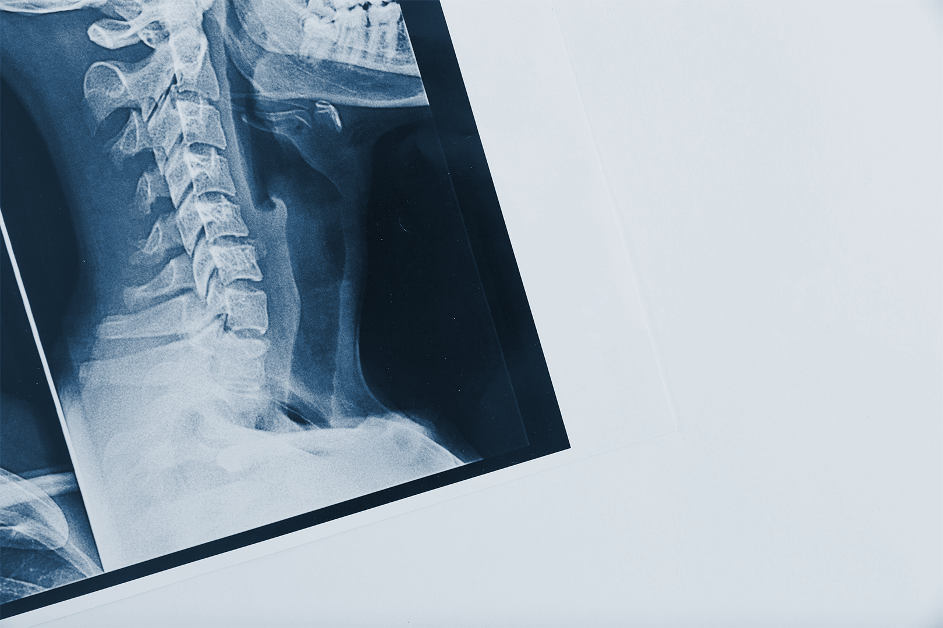
INTRODUCTION
Medical imaging plays a vital role in healthcare, providing detailed information for diagnosing and tracking illnesses.
Radiologists spend significant time examining images and writing reports, often facing challenges in accuracy and efficiency.
Indecisive findings in reports may necessitate further tests, contributing to delays and inefficiencies in patient care.
The time-consuming nature of report writing, averaging 10 minutes or more per report, poses challenges, particularly in busy hospital settings.
These challenges motivate research into deep learning models to automate report writing, aiming to improve efficiency and accuracy in medical imaging diagnosis and reporting.

Slide 5
02. Literature Review
Reference | Description | Year | Limitation
[1] | EfficientNet and VGG are popular CNN architectures for chest X-ray classification. EfficientNet achieves high accuracy with fewer parameters, making it computationally efficient. Tuli et al. (2020) found EfficientNet outperformed ResNet and VGG in COVID-19 detection. VGG-16, despite its simplicity and solid performance, incurs higher computational costs compared to modern architectures like EfficientNet. | July 2020 | EfficientNet and VGG focus on efficient and accurate classification but lack the capability to generate detailed diagnostic reports.
[2] | CNNs are widely used for chest X-ray classification, achieving radiologist-level accuracy. Liu et al. (2020, 2021) achieved over 90% accuracy in detecting COVID-19 and pneumonia using CNN and ResNet architectures. These models have significantly advanced automated disease detection from X-rays. | June 2021 | While CNN-based models excel in disease detection, they primarily focus on classification rather than generating comprehensive diagnostic reports.

Slide 6
02.Literature Review
Reference | Description | Year | Limitation
[3] | Automating radiology report generation using language models like GPT-3 and GPT-4 has shown significant potential. Yang et al. (2021) demonstrated that GPT-3 could generate coherent and relevant chest X-ray reports aligned with radiologists' descriptions. GPT-4, with enhanced language understanding, further improves accuracy and applicability, particularly in regions with limited radiology expertise. | March 2022 | While GPT-based models excel in generating text, they may lack the integration of image-specific insights directly from CNN outputs.

Slide 7
03.Summary of Literature Review
CNN models like ResNet, EfficientNet, and VGG excel in classification but struggle with multi-class disease detection and dataset imbalances. GPT-based models are effective for report generation but lack direct integration with CNN outputs and require extensive fine-tuning. Your FYP bridges these gaps by combining tailored disease detection and seamless report generation for a more comprehensive solution.

Slide 8
04.Problem Statement
The manual process of generating radiology reports for medical imaging data is time-consuming, leading to delays in patient care. Human error and variability in report creation can impact diagnosis accuracy. The need for an efficient and standardized approach to radiology reporting is critical in modern healthcare settings.

Slide 9
05. Aims and Objectives
Aim :
To develop an advanced automated system that utilizes deep learning and AI integration to generate precise and detailed radiology reports from chest X-ray images for accurate diagnosis of pneumonia, tuberculosis, and COVID-19.
Objectives:
Data Collection: To collect the dataset of selected diseases.
Data preprocessing: Apply noise reduction, normalization, and feature enhancement for quality optimization.
Model Development: Train a deep learning model for accurate multi-class disease classification.
AI Integration: Use OpenAI API to generate automated, professional radiology reports.
System Validation: To evaluate the overall performance.

Slide 10



06. Mapping of project with SDGs & CEP

Slide 11
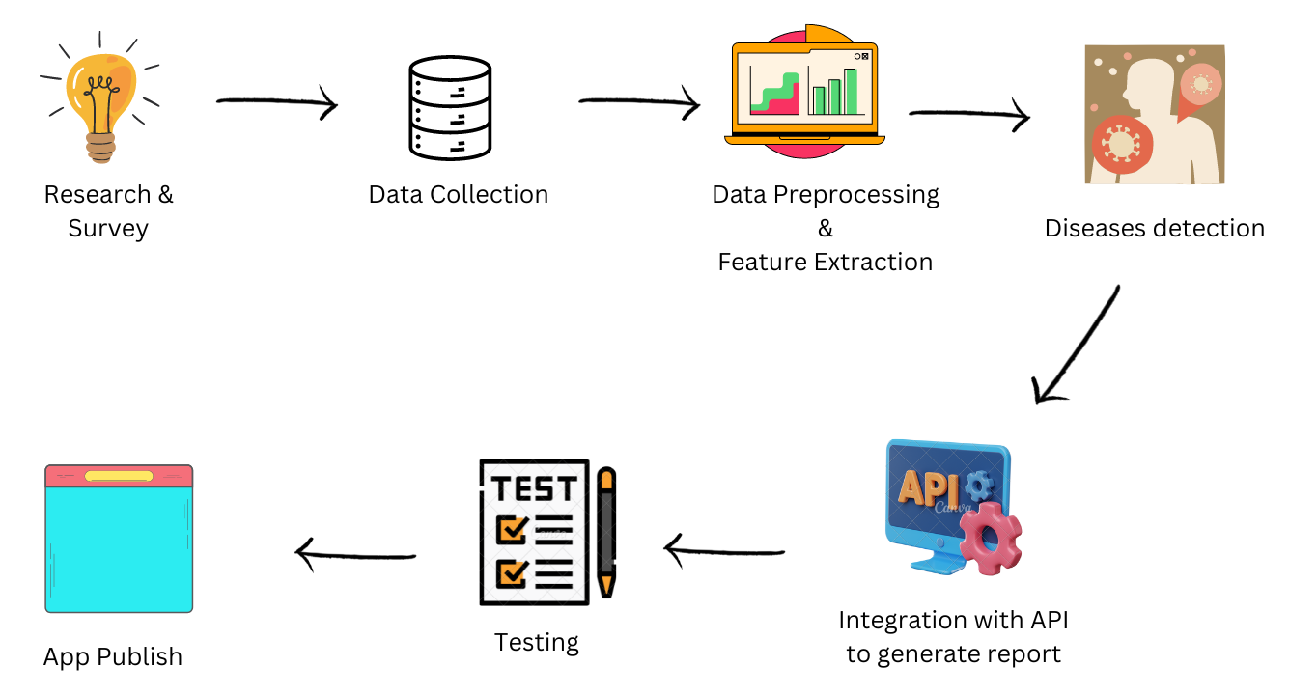
07. Methodology

Slide 12


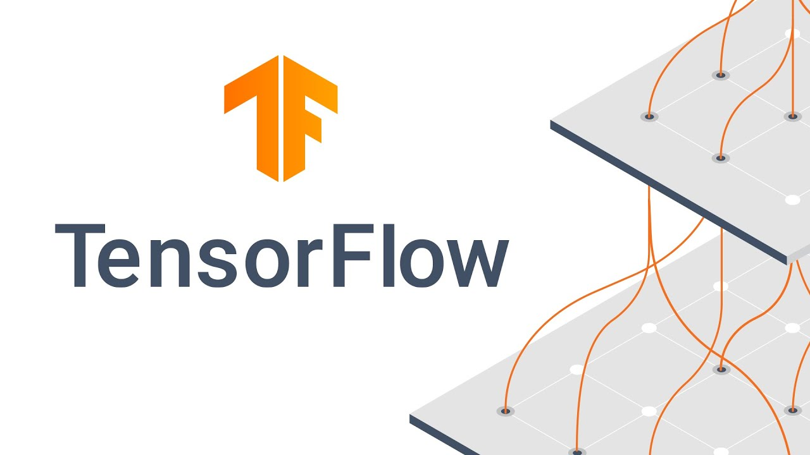

08. Tools & Technologies
Tools:
Jupyter Notebook
Dataset from Kaggle related to our project.
NVIDIA Quardo P200 GPU
Technologies:
Python
Deep Learning (CNN)
GPT-4o API
Gradio

Slide 13
Dataset Description
The dataset which is used in this project is taken from www.kaggle.com website which provide a collaborative environment for data scientist to find and publish datasets.
Class | Number of Images | Labels
Pneumonia [4] | 5800+ | Normal Pneumonia
Tuberculosis [5] | 4100+ | Normal Tuberculosis
COVID [6] | 3600+ | Covid
We will combine these dataset for multiclass detection detecting overall four classes:
0: Covid
1: Normal
2: Pneumonia
3: Tuberculosis

Slide 14
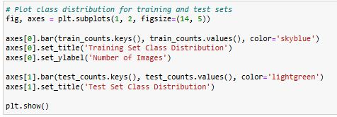
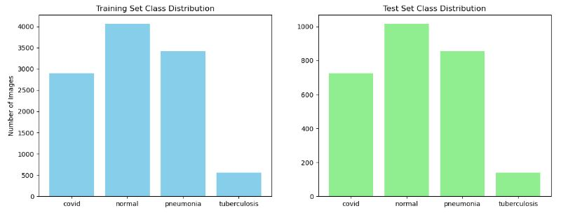
9. Data Preprocessing

Slide 15
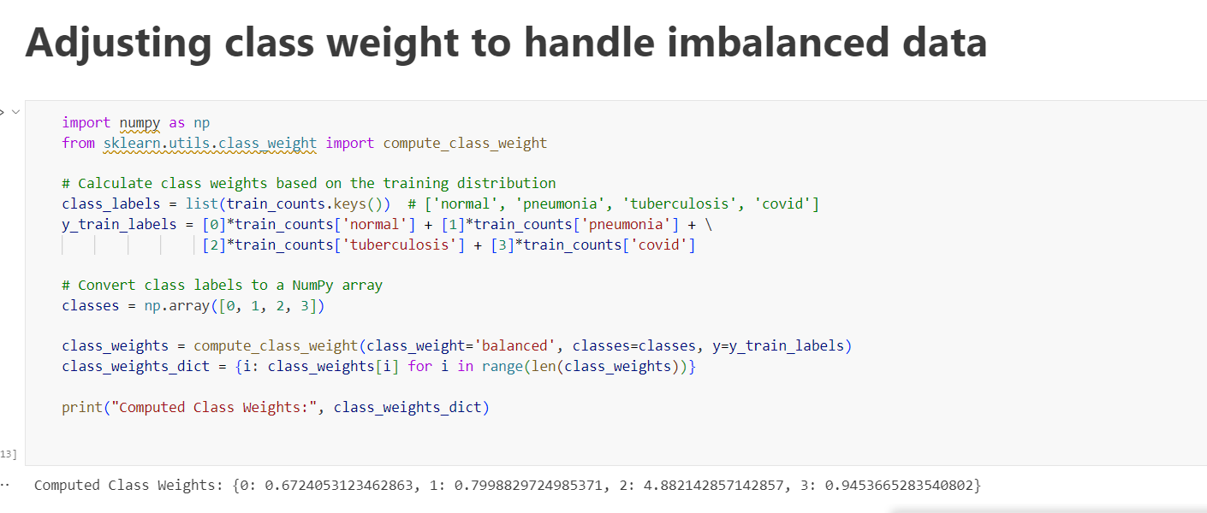
9. Data Preprocessing

Slide 16
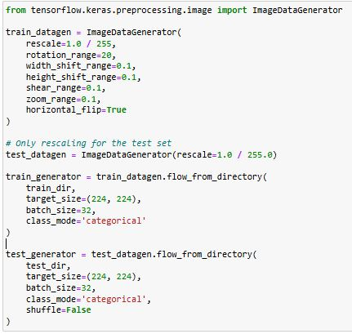
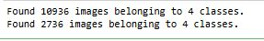
Data Preprocessing cont..

Slide 17
Model Architecture
Model | Input Size | Trainable Layers | Batch Size | Learning Rate | Dropout Rate | Epochs | Optimizer | Precision
ResNet50 | 196x196 | Last 30 | 32 | 0.001 | 30% | 25 | Adam | Mixed Float16
EfficientNetB0 | 196x196 | Last 30 | 32 | 0.001 | 30% | 25 | Adam | Mixed Float16
VGG16 | 196x196 | Last 4 | 32 | 0.001 | 50% | 25 | Adam | Default
Custom CNN | 196x196 | All Layers | 32 | 0.001 | 50% | 25 | Adam | Default

Slide 18
Model Accuracy
CNN Architecture | Accuracy
Custom Architecture | 60 %
ResNet | 65 %
EfficientNetB0 | 31 %
VGG16 | 92 %

Slide 19
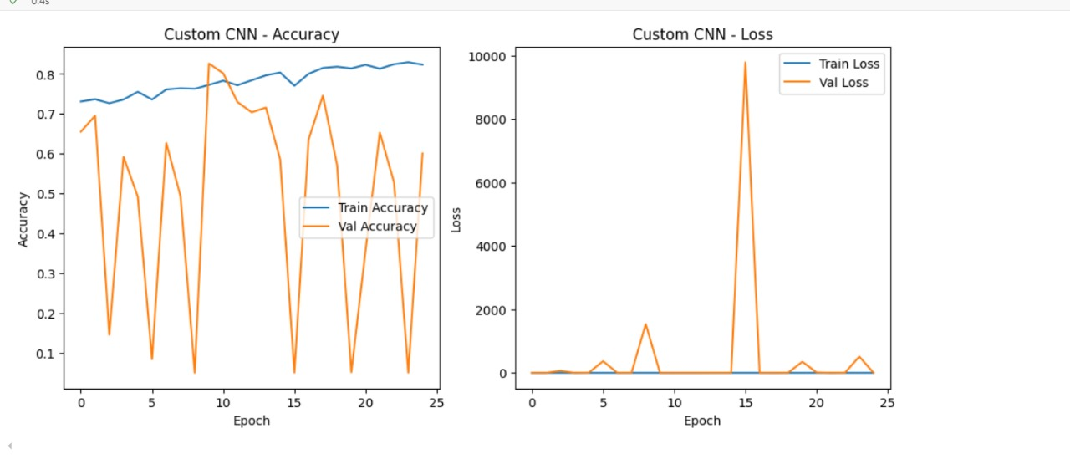
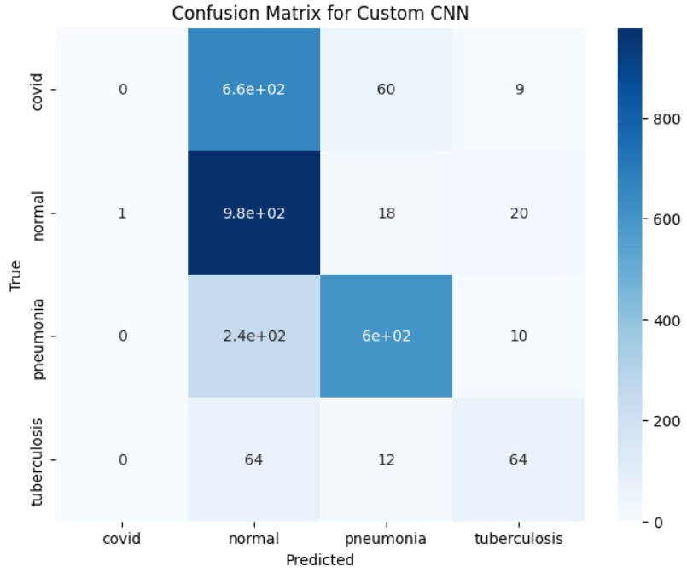
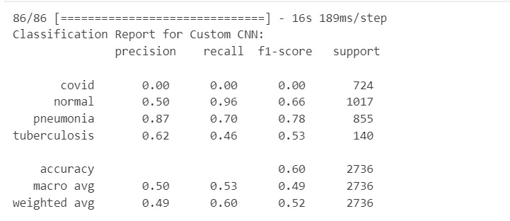
Custom CNN Model Statistics

Slide 20
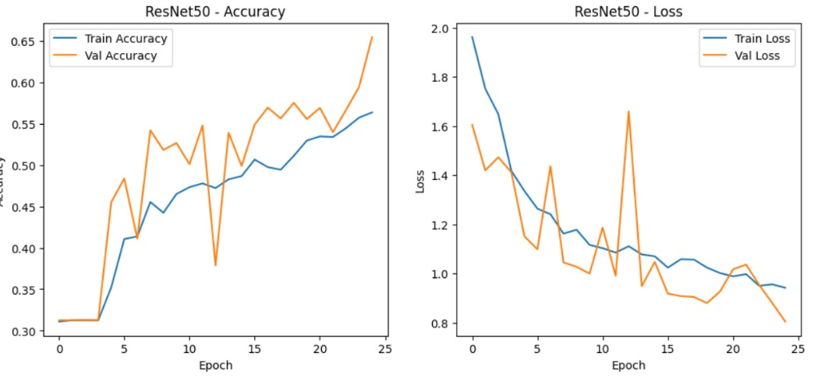
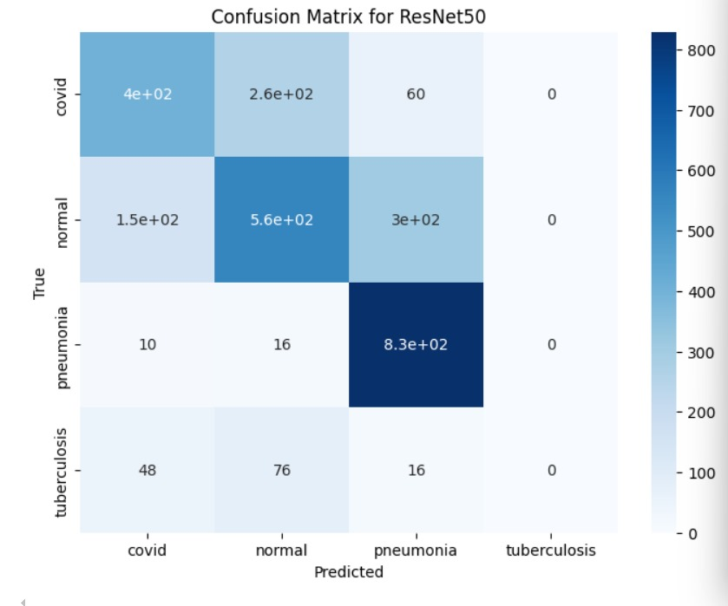
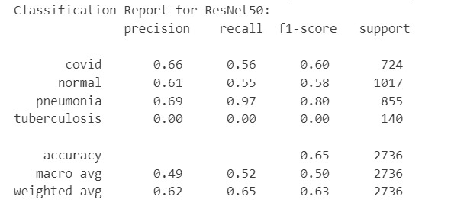
ResNet50 Model Statistics

Slide 21
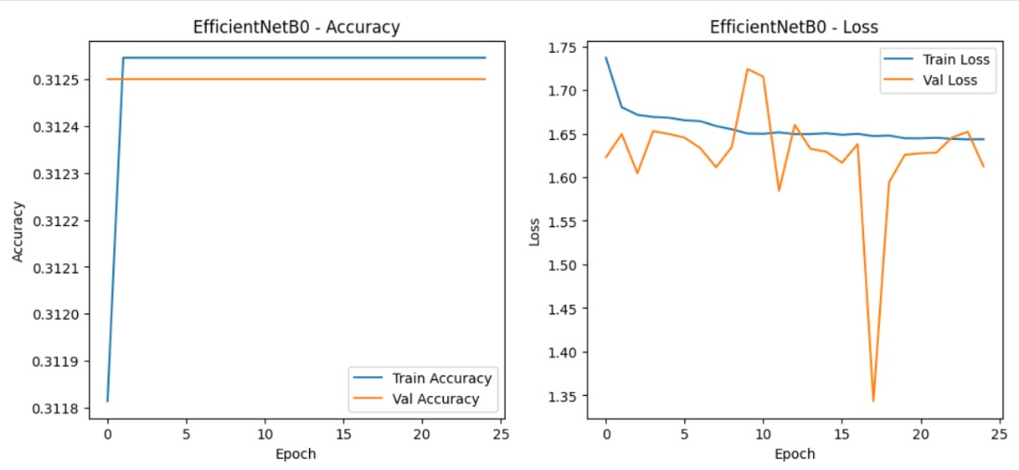
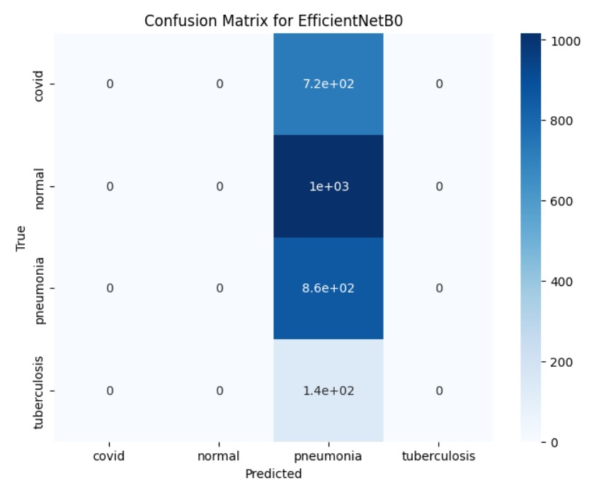
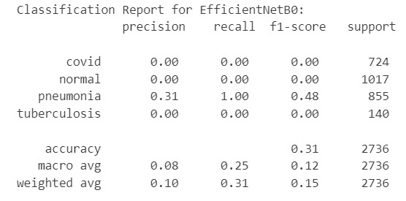
EfficientNetB0 Model Statistics

Slide 22
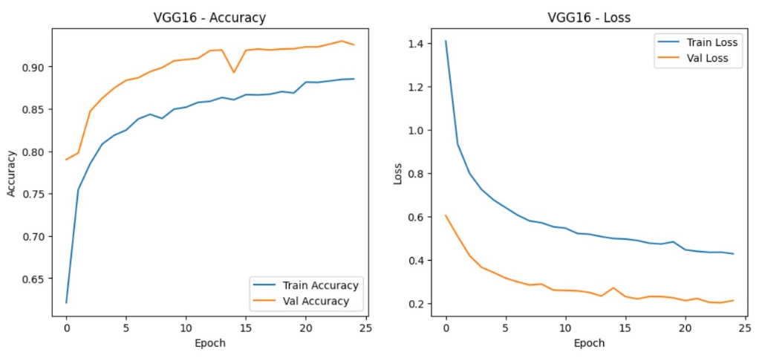
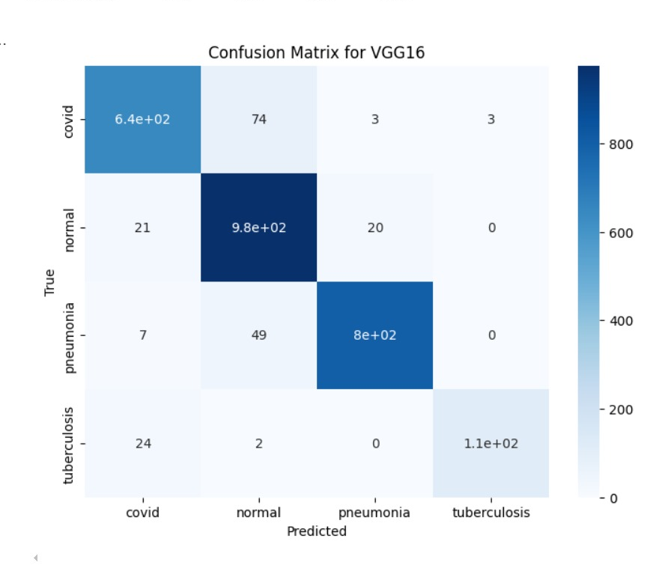
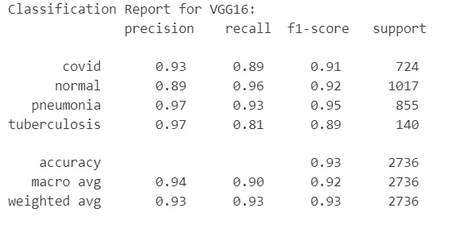
VGG 16 Model Statistics

Slide 23
10 . Model Evaluation and Selection
Based on the classification reports for your custom CNN, ResNet50, and VGG16, the best model architecture is VGG16.
High Accuracy:
VGG16 achieves an accuracy of 92%, which is significantly higher than the custom CNN (60%) , EfficientNetB0 (31%) and ResNet50 (65%).
Consistent Precision, Recall, and F1-Score:
VGG16 has consistently high precision, recall, and F1-score across all four classes.

Slide 24
11. Verification of Generated Reports
To validate the accuracy of our generated reports, we had 8 to 10 samples reviewed by chest specialist Dr. Ganesh Khatri at New Civil Hospital, Mirpurkhas. He confirmed that all the reports were generated correctly, aligning well with clinical standards.

Slide 25
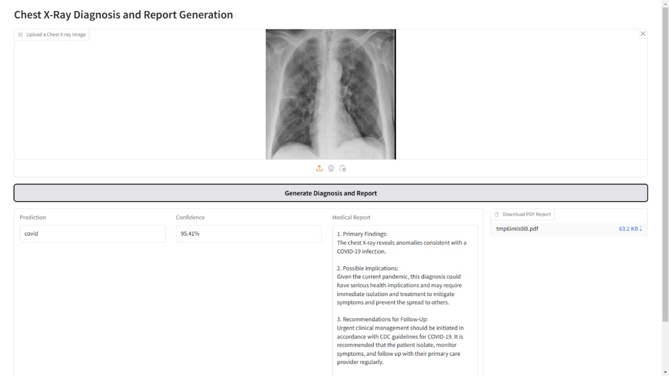
11. Results
1. Upload a Chest X-ray Image:

Slide 26
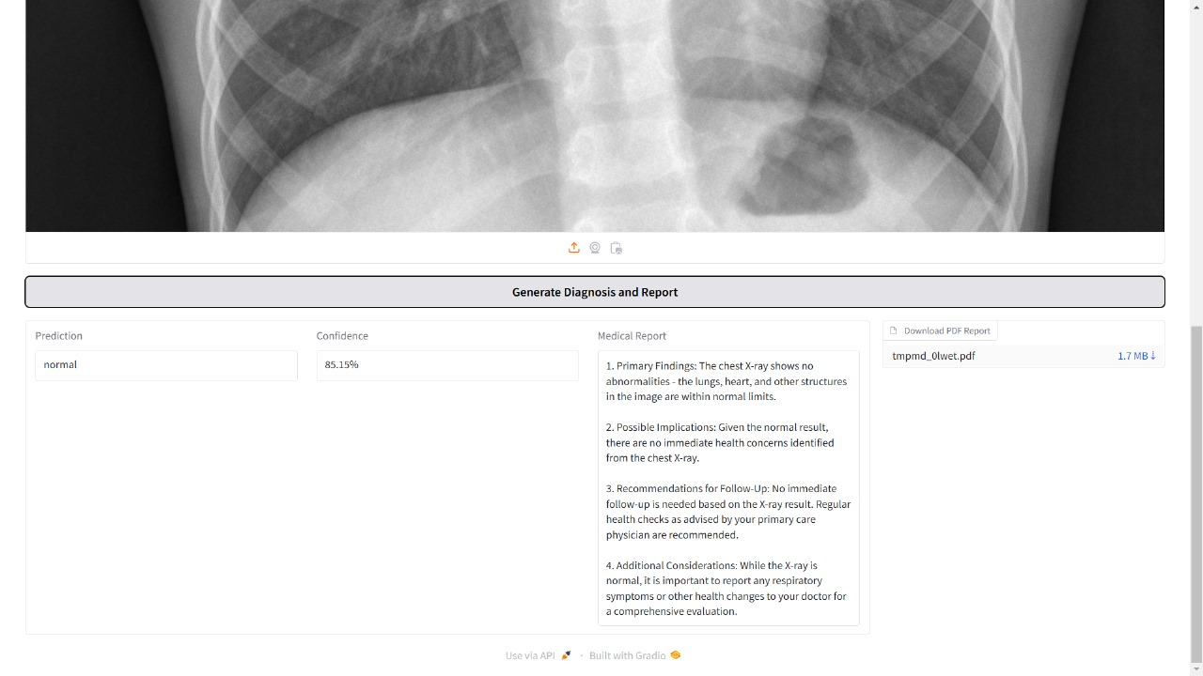
Results
2 .Generate Diagnosis and Report:

Slide 27
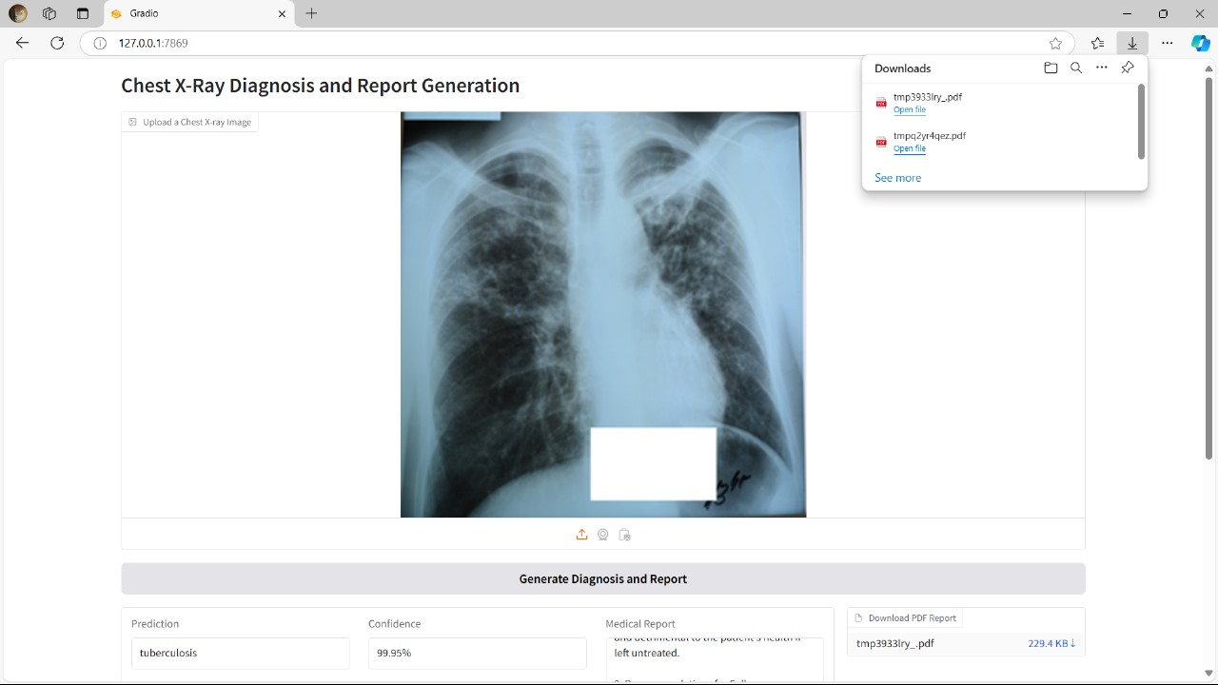
Results
3 .Download the report

Slide 28
12. References:
1. A. Tuli et al., "COVID-19 Detection using EfficientNet in Chest X-ray Images," International Journal of Imaging Systems and Technology, vol. 30, no. 4, pp. 818–827, 2020. https://onlinelibrary.wiley.com/doi/abs/10.1002/ima.22445
2. L. Liu et al., "Deep Learning for COVID-19 Detection in Chest X-rays: A Comprehensive Review," IEEE Access, vol. 9, pp. 95612–95628, 2021. https://ieeexplore.ieee.org/document/9463662
3. Z. Yang et al., "AI-Based Radiology Report Generation using GPT-3," J. Med. Imaging, vol. 8, no. 4, pp. 148–155, 2021. https://pubmed.ncbi.nlm.nih.gov/33918748/
4. P. T. Mooney, "Chest X-ray Images (Pneumonia)," Kaggle. [Online]. Available: https://www.kaggle.com/datasets/paultimothymooney/chest-xray-pneumonia. [Accessed: Dec. 2, 2024].
5. T. Urrahman, "Tuberculosis (TB) Chest X-ray Dataset," Kaggle. [Online]. Available: https://www.kaggle.com/datasets/tawsifurrahman/tuberculosis-tb-chest-xray-dataset. [Accessed: Dec. 2, 2024].
6. P. Viradiya, "COVID-19 Radiography Dataset," Kaggle. [Online]. Available: https://www.kaggle.com/datasets/preetviradiya/covid19-radiography-dataset. [Accessed: Dec. 2, 2024].

Slide 29
Thank You

